Slide 1
An Intro To Machine Learning

Slide 2
Who am I?
Brian Uptagrafft
Senior Software Engineer
brian.uptagrafft@intellitect.com
@brianupta
github.com/upta
Notes:
Experience in all sorts of things; mobile, web, desktop, games… a dabbler
Disclaimer: Not an expert.
Use that to our advantage; struggles of getting started are still relatable
Idea is to have a primer that isn’t too overwhelming to help you get started

Slide 3
Basics
What is Machine Learning?
Teaching a computer how to learn to act like a human
by feeding it inputs from real-world data and observations
Unsupervised
Looking for groups / anomalies
Supervised
Labeled data, so it can learn the differences
Most common
Notes:
Learning – what makes it different, modifies itself based on previous results
Unsupervised
Give it data and have it find patterns/anomalies on its own
Anomalies in credit card transactions (they use supervised, too)
Supervised – most common / what we’ll focus on
Give it data with labels so it can learn to tell the difference between them

Slide 4
Basics
Machine learning isn’t one thing; it’s many
“Machine learning” is a very broad category of methods
There is no one-size-fits-all
Specific problems take specific solutions
These things can get complicated…

Slide 5
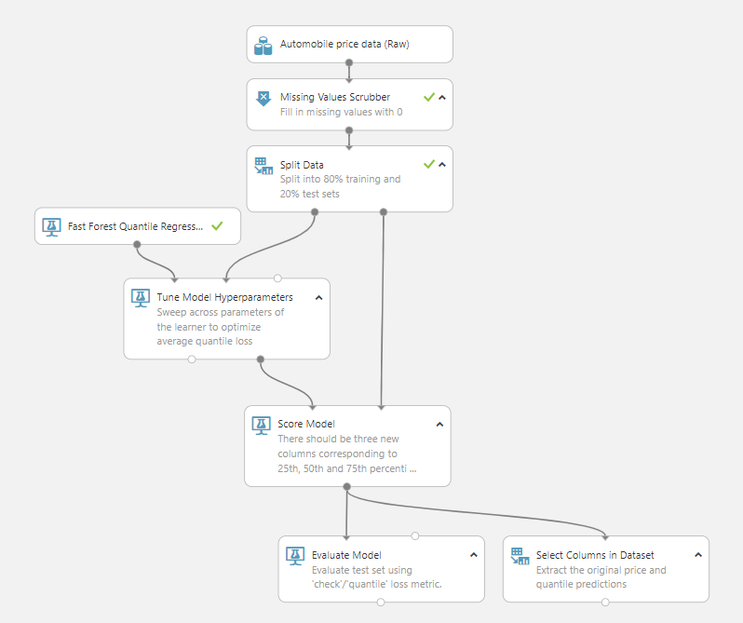

Slide 6
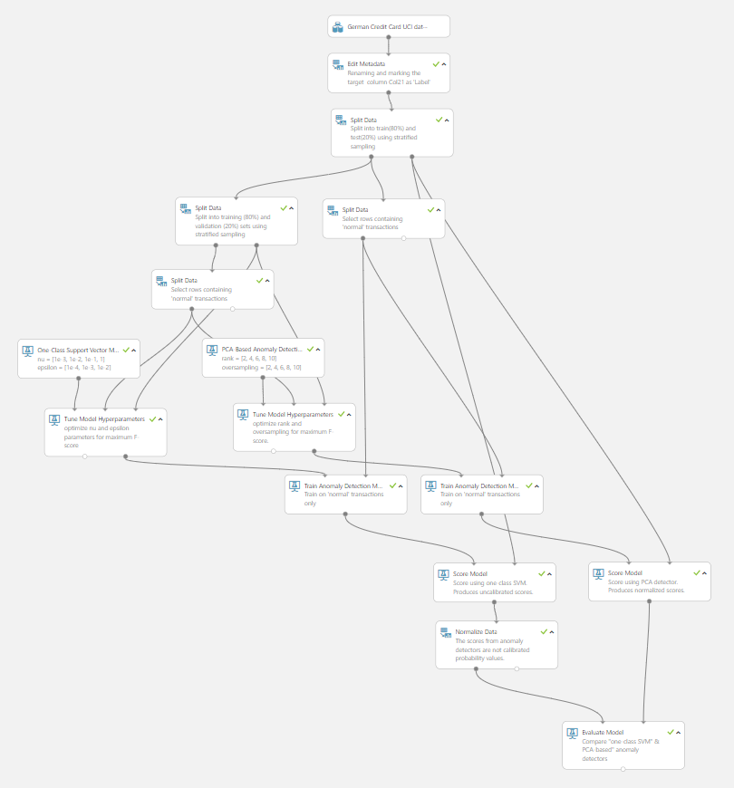

Slide 7
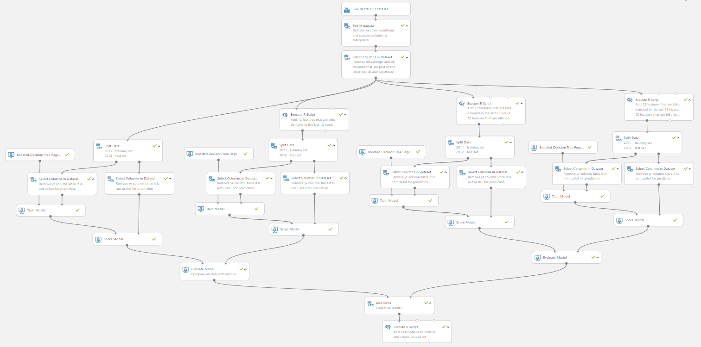

Slide 8
Tip
Don’t panic!
You’re eating an elephant; one bite at a time
Define and focus on your specific problem
Notes:
There are SO many algorithms and options it’s daunting
Thankfully smarter people that me have sorted out the math involved in these algorithms, it’s a lot to simply learn how to leverage them

Slide 9
Tools
State of affairs
There are a lot of options
Feels a bit like the “wild west” days of the early web
But it’s getting better
Big players like Google and Microsoft are investing a lot to make ML more accessible
Notes:
Random third parties as well as the likes of Google and Microsoft
Even within Google/Microsoft there are different options, muddying the waters further

Slide 10
Tools
What’s out there?
TensorFlow
Microsoft Cognitive Toolkit (formerly CNTK)
PyTorch
Keras
Azure ML Studio
So… many… more…
Notes:
Tensorflow –Made by Google. Lots of community support. Mobile support
CNTK – Stronger at some tasks, better engineered, faster. Less popular / well marketed
PyTorch – Made by Facebook. Takes different approach to it’s underlying graphs. Gaining popularity
Keras – Higher-level, more approachable tool for using TensorFlow or CNTK
Azure ML Studio – Flowchart-esq tool for building and deploying ML models

Slide 11
Tip
Learn some Python
Most ML tools and demos are Python-oriented
There are tools for other languages, but fewer resources for learning using them
Notes:
Probably be hearing about ML.Net if you haven’t already
Make ML more approachable to us C# developers

Slide 12
Demo
Azure Machine Learning Studio
Notes:
Full disclosure: shameless stole the example from MS
Went to make one myself, but found they’d done a good job distilling the concepts
We’re going to be predicting the price of a car based on some historical data
Mention that, regardless of method, training follows the same general flow of:
- Prep
- Train
- Score

Slide 13
Image Recognition
Types
Classification
Labeling whole photos
Object Detection
Bounding boxes
Labeling the bounding boxes

Slide 14
Image Recognition
Neural Networks
"Deep Learning"
Marketing term for complex neural networks
Variants power the things we think of as “AI” in modern life
Face recognition
Speech recognition
Self-driving cars

Slide 15
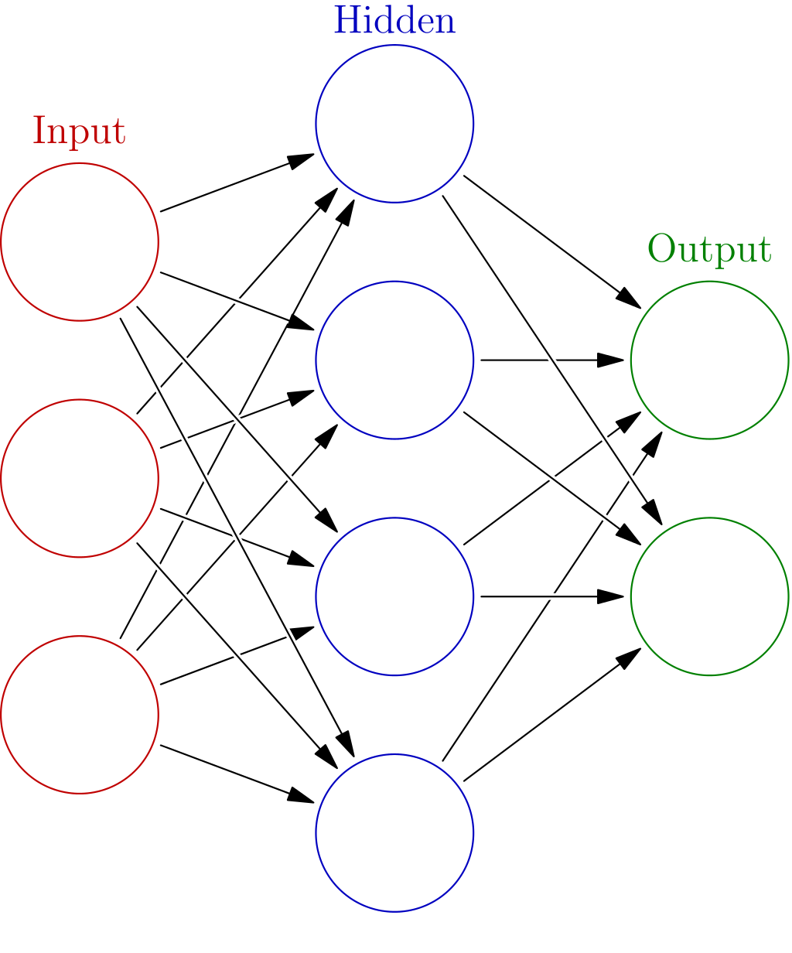
Notes:
Inputs (features) -> Black Magic & Calculus -> Outputs (predictions)
Evaluate the outputs against the input, slap hand/give cookie and try again

Slide 16
Image Recognition
MNIST
Database of hand-written digits, 0-9
Often used as a “Hello World” for algorithms
Notes:
Modified National Institute of Standards and Technology

Slide 18
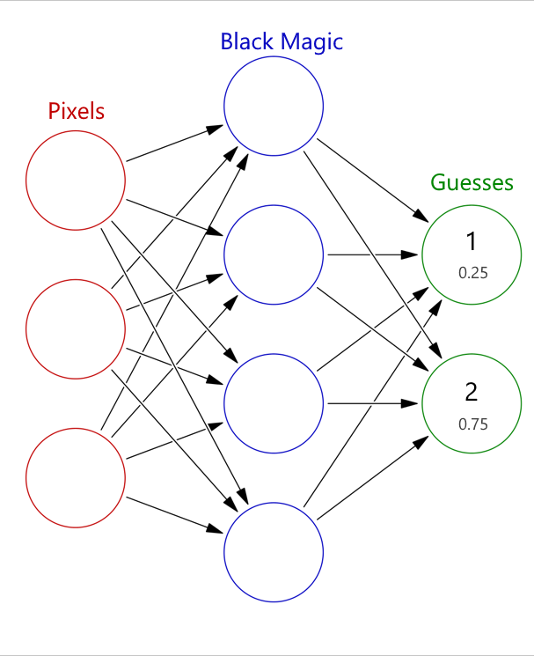

Slide 19
Image Recognition
Transfer Learning
“Deep Learning” algorithms have lots of hidden layers
Being complex makes them expensive / slow to train
Notes:
In the real world, we’re not usually working with 28x28, greyscale images.
As our needs become more complex, our solutions grow more complex to accommodate them

Slide 21
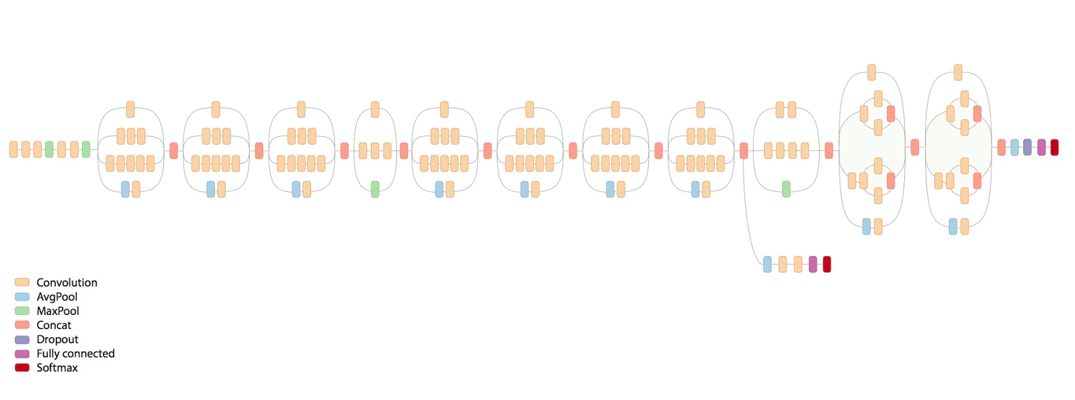
Inception v3

Slide 22
Image Recognition
Transfer Learning
“Deep Learning” algorithms have lots of hidden layers
Being complex makes them expensive / slow to train
Transfer learning allows us to take a pre-trained model and simply retrain the last layer, instead of the whole thing
Notes:
Turns out being able to tell the difference between some objects can help tell the difference between others

Slide 23
Image Recognition
State of affairs
Even deeper in the “wild west”
Harder, takes more compute power
Again, big players are working to make it more accessible, but it’s still fairly early
Azure Computer Vision
Azure Custom Vision / Cloud AutoML
Notes:
Computer vision – Has support for things like OCR, Face detection, “adult” content, smart thumbnails, etc
Custom Vision & Cloud AutoML - Transfer learning services

Slide 24
Project: Meter Reading
Explanation
Goal – Read the value of an analog electric meter
Plan – Use Azure Custom Vision to label individual dials
Assumption – Images are oriented somewhat normally
Notes:
Let me tell you a story my own experiences
an eck dote

Slide 25


Project: Meter Reading
Reading a meter
Set of analog dials that add up to a value
Ones, tens, hundreds, etc
Only focusing on 5 dial meters
Still many makes/models to identify
How to read a meter?
Notes:
Think about the hour hand; any position between two numbers belongs to the lower number
Without the smaller number (minute hand) we don’t have all the necessary context

Slide 26


Project: Meter Reading
Explanation
Set of analog dials that add up to a value
Ones, tens, hundreds, etc
Only focusing on 5 dial meters
Still many makes/models to identify
How to read a meter?

Slide 27
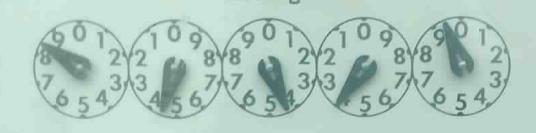
8
4
4
3
9

Slide 28
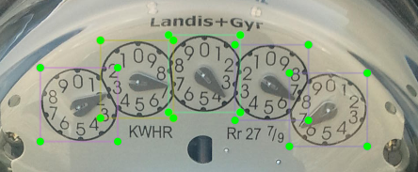
Project: Meter Reading
Identifying Dials
Drawing bounding boxes around dials
Tedious, but necessary
If we want it to think like a human, we need to show it how a human thinks
Notes:
Initially just tried to get it to find the dials, not worrying about the number
Can label/draw boxes on the site but I wanted to do it from code so I could recreate from scratch if needed and put in source control
Used a free tool called LabelImg to draw boxes
Custom Vision did a surprisingly good job even out the gate with few pics

Slide 29
Tip
Embrace building your dataset
If you have a specialized use-case, there’s no getting around the need for specialized training data
If you need a lot of it done, you might consider looking into something like Amazon Mechanical Turk
Notes:
2) This is why Recaptcha does what it does (used to be text, now it’s cars)

Slide 30
Project: Meter Reading
Reading Dials
Passing numbered dials to a Custom Vision model
… had problems
Every other dial rotates counter-clockwise; maybe it’s better to break the process up?
I can do pre-processing on images if needed
Maybe the Classification model will do better?
… even more Custom Vision problems
Notes:
Failed spectacularly… like 23%. Was better than pure guessing, but not much
Issues
- Individual dials have no context to help with “coin flips”
- Some dials are counter-clockwise
Tried classification, failed harder

Slide 31
Project: Meter Reading
Reading Dials
Decided to try out TensorFlow using retrain.py
Results were okay (and certainly better than no results)
Tested both flipping every other image and not flipping
Saw about 5% improvement when flipped
Notes:
Retrain.py – At least I wouldn’t have to keep uploading the images
Was about 50% accurate out the gate

Slide 32
Tip
Assumptions and breaking things apart
If you can make assumptions you can really shrink your problem space
Breaking the problem up into smaller pieces can make it more manageable
Notes:
Assumptions I made:
- 5 dials
- Every other dial is counter clockwise
- Images oriented reasonably

Slide 33
Project: Meter Reading
More data required
Extra photos helped the model improve
Notes:
Maybe I just need more pictures!

Slide 34
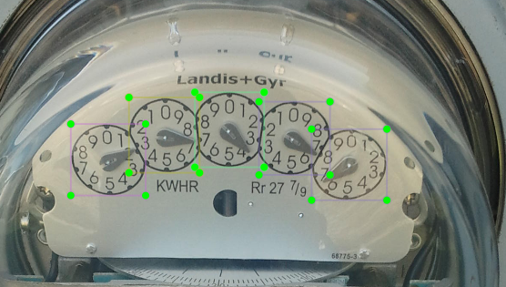

Slide 35
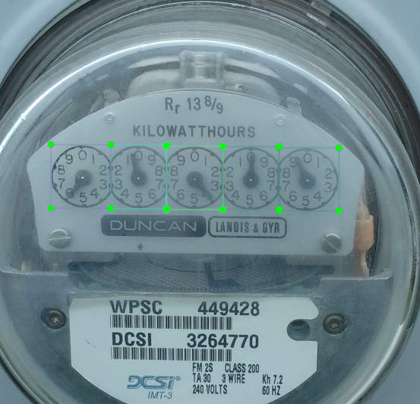

Slide 36
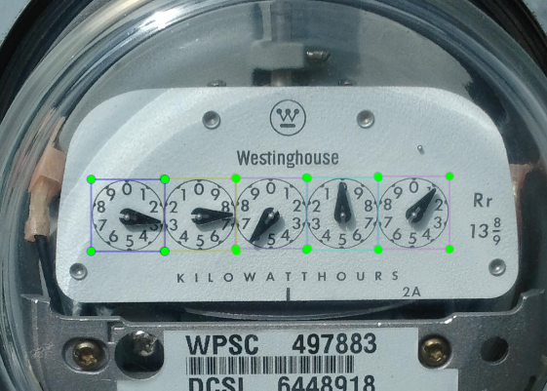

Slide 37
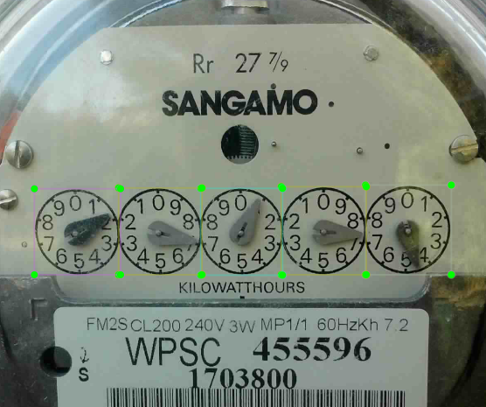
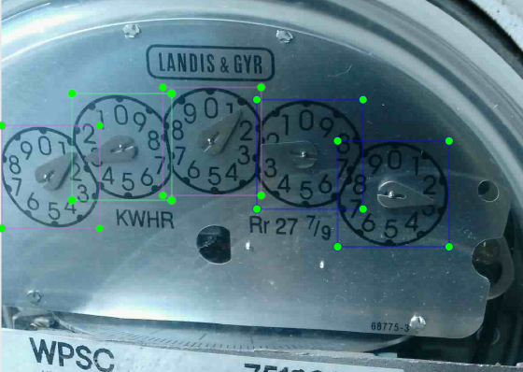

Slide 38
Project: Meter Reading
More data required
Extra photos helped the model improve … slowly
Ended up drawing bounding boxes on over 1400 images
Pleasant side-effect
I now had a LOT of images to train the box detection model

Slide 39
Project: Meter Reading
Process Improvement
Dial detector now has a ton of data and is quite accurate
Started using it to draw the boxes for me; I only had to supply the number
Built a small WPF app to help me number them
8x faster than drawing the box and providing the label
Notes:
Automatically tabs between textboxes and saves when I’m done, keyboard shortcut to reject a photo, etc

Slide 40
Project: Meter Reading
Process Improvement
Picking dial meter photos out of the raw images was now the biggest pain point
Not all dial meters (or meters at all)
Sometimes rotated 90°
Used a batch I’d done manually to build a Custom Vision model to classify them
Even just that dataset produced 90%+ accuracy
Notes:
Collection of photos was everything from blurry messes, to digital meters, to 100ft away to pictures of the ground

Slide 41
Tip
Build small helper apps
“Scratchpad” coding and personal apps might save you some manual work
It’s refreshing to write code when you’re the only user

Slide 42
Project: Meter Reading
Finishing up
Project was put on hold
Latest version was about 78% accurate when
identifying a dial
3500 meter images

Slide 43
Project: Meter Reading
Finishing up
Plan for the final process
Predict the type of meter using a Classification model
2. Detect the dials using an Object Detection model
Predict the value for of each of the dials, right to left
If the prediction is a “coin flip”, use the previous dial as a tie-breaker

Slide 44
References
Slides and References
github.com/IntelliTect-Samples/UserGroupTalk-2019.04.09
Notes:
Thanks for putting up with me
Hope this helped demystify Machine Learning at least a little bit

